Slide 1
Keep
Calm
And
identify
Hello.
I’m Kiya.
Learning Target:
I will be familiar with the PPS TAG identification process.

Slide 2
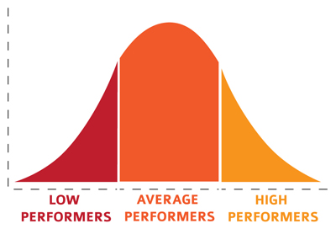
Fun fact:
What is the one common trait?

Slide 3
Aug/Sept/Oct ish- know your kids, observe, assess, collect data, PPS screener for all 2nd grade students, send parent/student survey for identified
Timeline (in pps…)

Slide 4
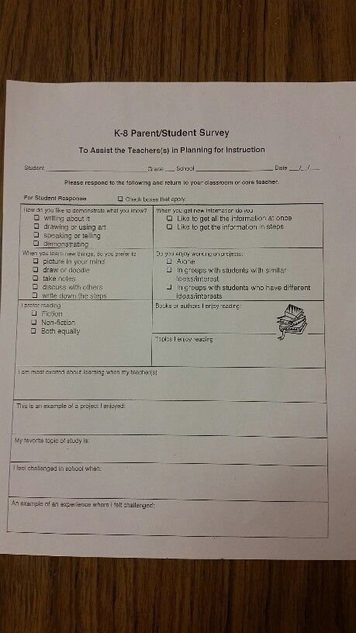
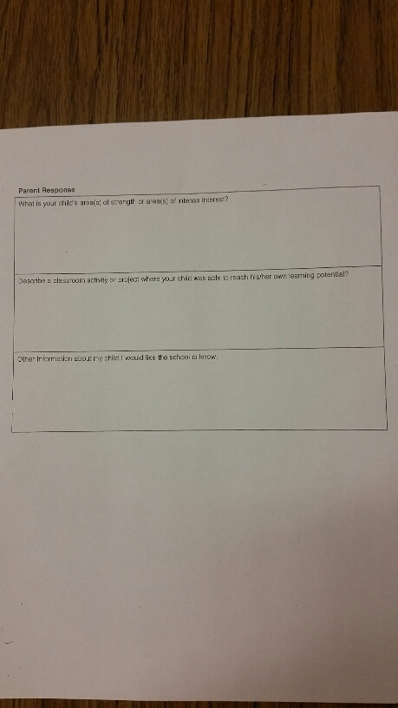
Parent/Student Survey

Slide 5
Nov ish-
Parent/Teacher conferences: Individual TAG plan or building TAG plan (sign waiver)? AND nomination time...
Timeline (in pps…)

Slide 6
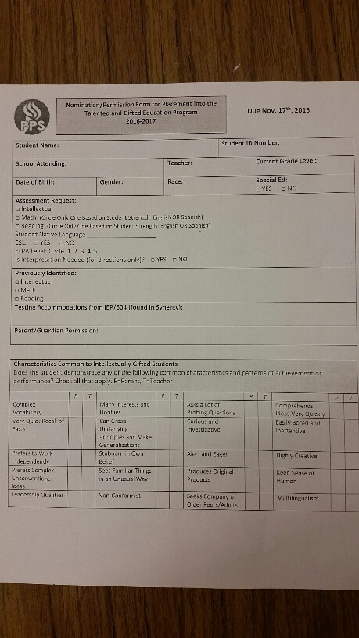
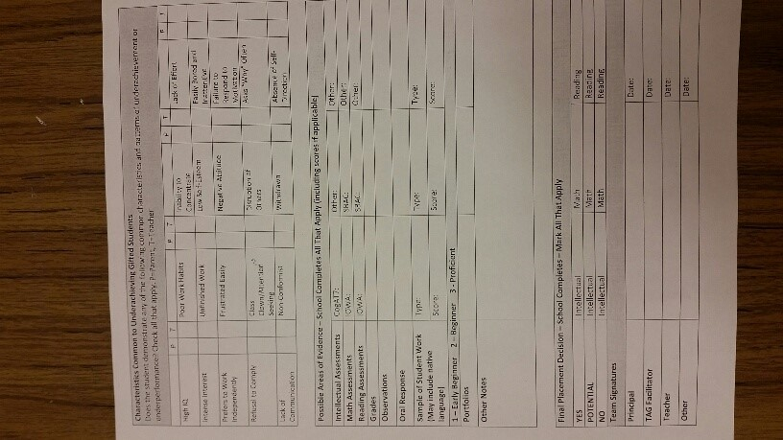
IDPF Identification process form

Slide 7
Jan ish- PPS TAG test administrator to schools to assess, if TAG plan requested, sign and finalize within 30 days (paid 1 hour)
Timeline (in pps…)

Slide 8
Feb/Mar ish- Single subject Acceleration Application window opens… get test results? SBAC may begin...
May/ June- Early Entry K application window closes, SSA closes...
Timeline (in pps…)

Slide 9
Youtube:
James and Susie
Know your kids.
Meet all learners at their rate and level.

Slide 10
Resources…
http://www.pps.net/Domain/196 (Portland Public)
http://www.evergreenps.org/Article-View/excel-program (Evergreen School District, WA)
nagc.org (National Association Gifted Children)
hoagiesgifted.org
OATAG.org

